Slide 1
Load.in
Give your move a game plan.
Team Yellow
Feasibility Presentation
Old Dominion University
9/26/2020
Notes:
This slide is a non-animated version of the following slide. (Title Slide)

Slide 2
Load.in
Give your move a game plan.
Team Yellow
Feasibility Presentation
Old Dominion University
9/23/2020
Notes:
This slide is an animated version of the previous slide. (Title slide)

Slide 3
Contents
Team Biography: 4
The Problem: 8-16
Problem Statement: 9
Problem Characteristics: 11-16
Current Process Flow: 17-19
Major Functional Component Diagram: 20-21
Competition: 22-23
References: 24
Glossary: 25

Slide 4



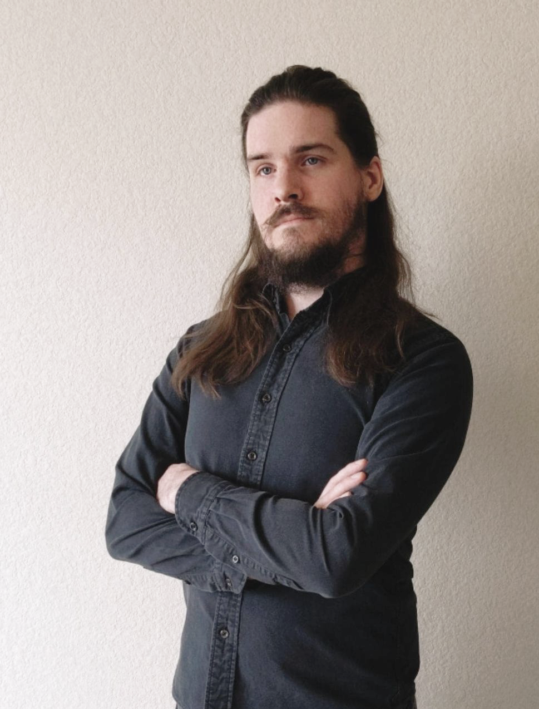



Who is Team Yellow?
Byron Aquilino
Lance Perdue
Greg Kukanich
Jason Moran
Daniel Reyna
Chris Miller
Paul Rodriguez

Slide 5
Problem/Customer Definition (Reword)

Slide 6
Most families cannot afford professional movers. When managing moving logistics and uncertainties, “Do It Yourself” movers are left to fend for themselves with little prior experience. Load.In aims to give your move a game plan by quantifying uncertainties and assisting in logistical endeavors on moving day.

Slide 7
Professional Movers Are Costly
Notes:
https://www.hireahelper.com/movers-academy/on-the-job/estimating-job-times/
https://www.uhaul.com/Reservations/RatesTrucks/
https://www.move.org/average-cost-truck-rental/
https://www.victoryvan.com/moving-and-storage/how-long-takes-move-new-house

Slide 8
Americans Prefer to Move Themselves

Slide 9
32,000,000 moves happen each year
34% of moves utilize a rental truck
If Load.In is used on 1% of those moves (0.34% of all moves) at a cost of $10, we make $1,088,000

Slide 10
Truck rental companies offer a variety of helpful moving supplies, but when it comes to the actual move, will only refer you to unaffordable professional movers. As a result, “Do It Yourself” movers are often left to fend for themselves in managing moving logistics and uncertainties with little prior experience. Load.In aims to give your move a game plan by quantifying uncertainties and assisting in logistical endeavors on moving day.

Slide 11
Professional Movers Are Costly
Based on 4 Movers at Average rate of $50/HR to $100/HR
https://www.mymovingreviews.com/move/average-moving-cost/

Slide 12
78.3% of Americans go without the help of professional movers.
MoveBuddha.com

Slide 13
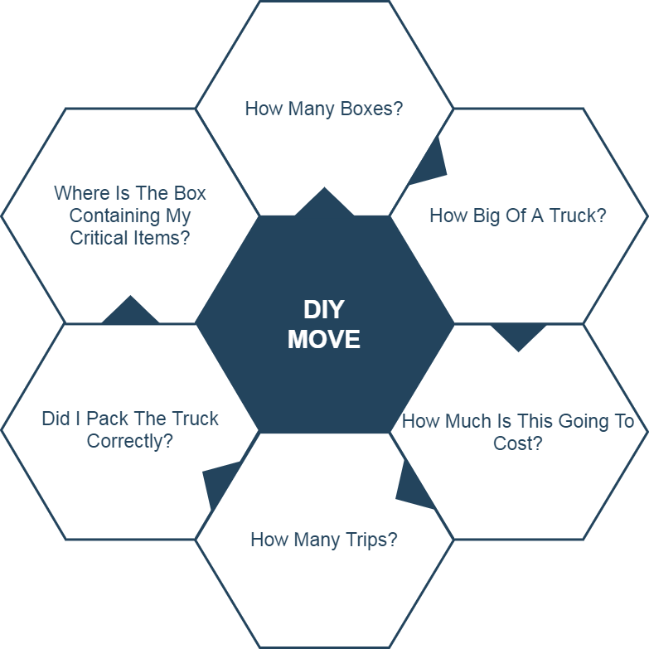
Moving is Challenging
These logistics make moving, which is already a stressful life event, even more stressful.

Slide 14
Accurately determining how big of a truck to get and how many trips a move will take is difficult. Rental Truck companies base their business model on this!
wtkr.com

Slide 15
Loading a truck properly requires many considerations including weight distribution and protecting fragile items.
PenskeTruckRental.com

Slide 16
Poor packing can result in property damage and in the worst case, a car accident. An estimated 50,000 accidents related to trailer towing occur each year.
Hayesbc.com

Slide 17
35% of Americans are stressed the most by logistics and packing.
Article.com

Slide 18
What is the current process?

Slide 19
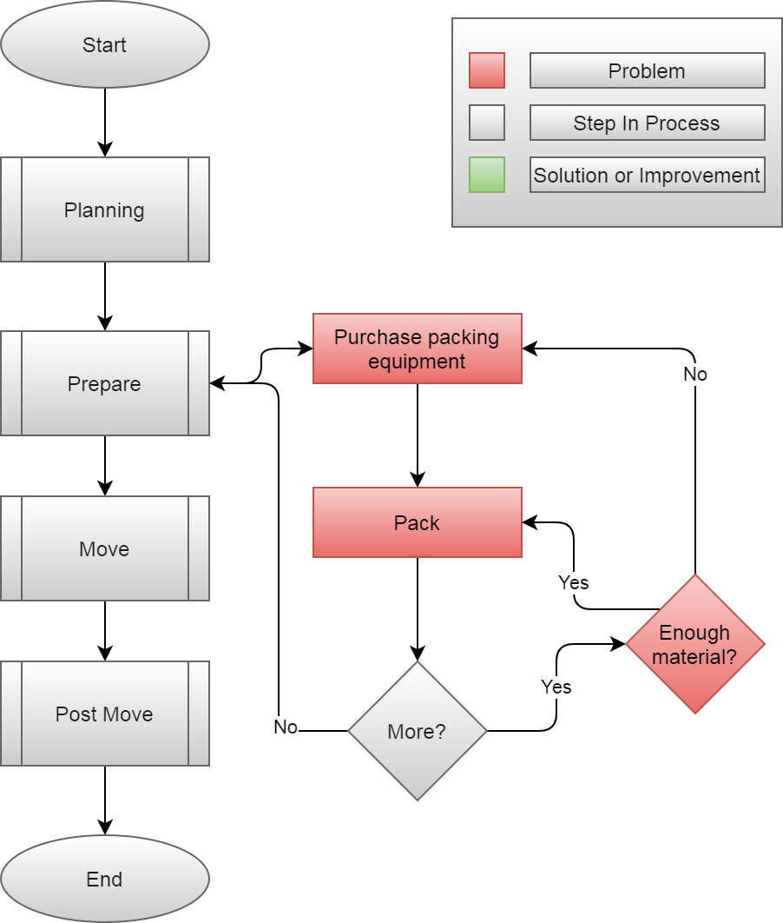

Slide 20
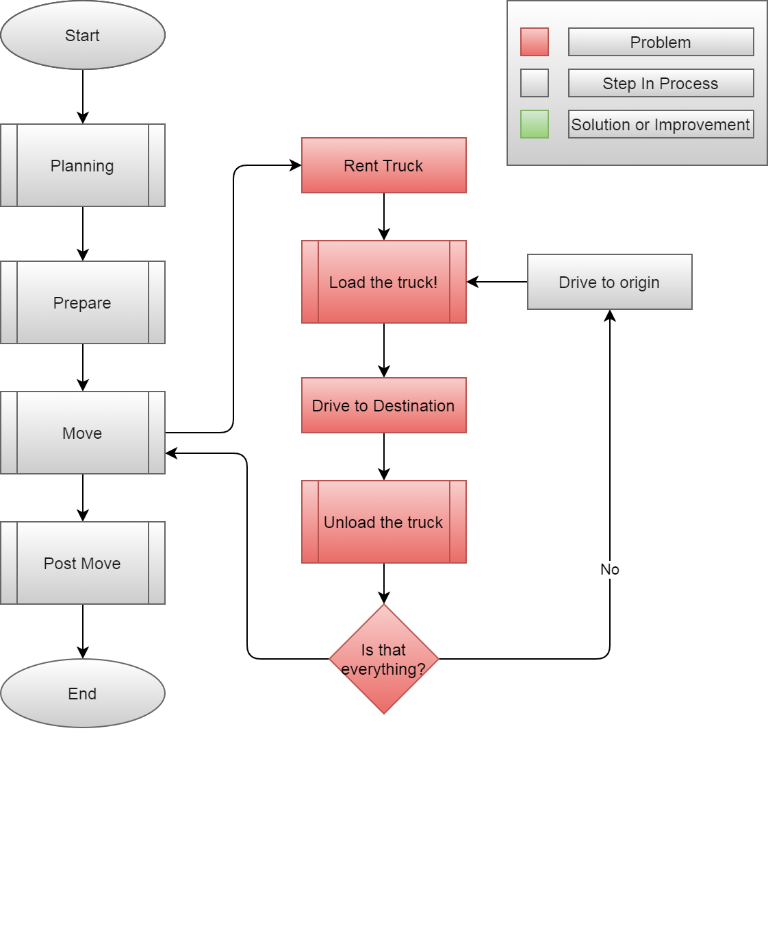

Slide 21
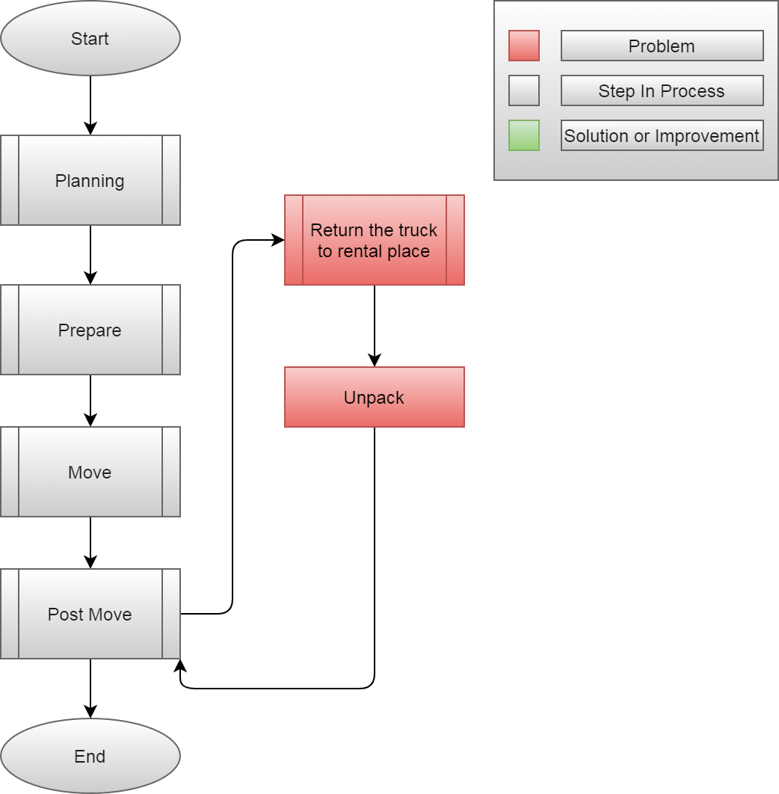

Slide 22
Solution Definition

Slide 23
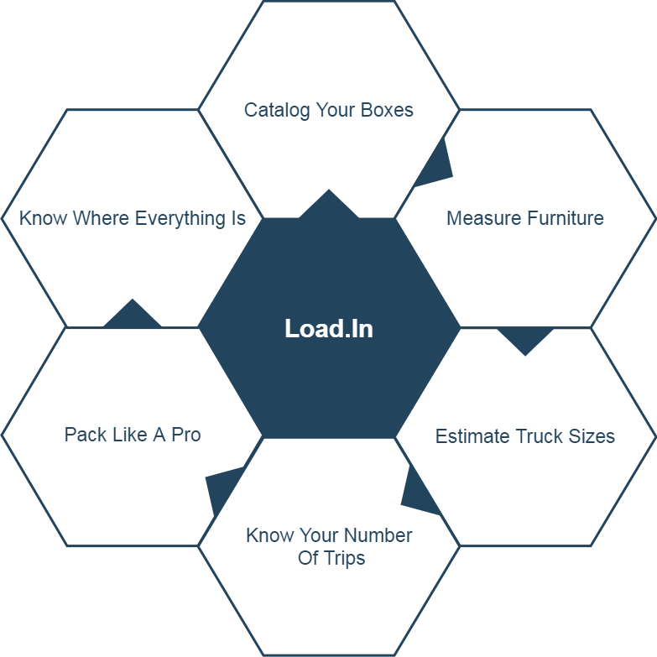
Solution Characteristics

Slide 24
How will the solution help the process?

Slide 25
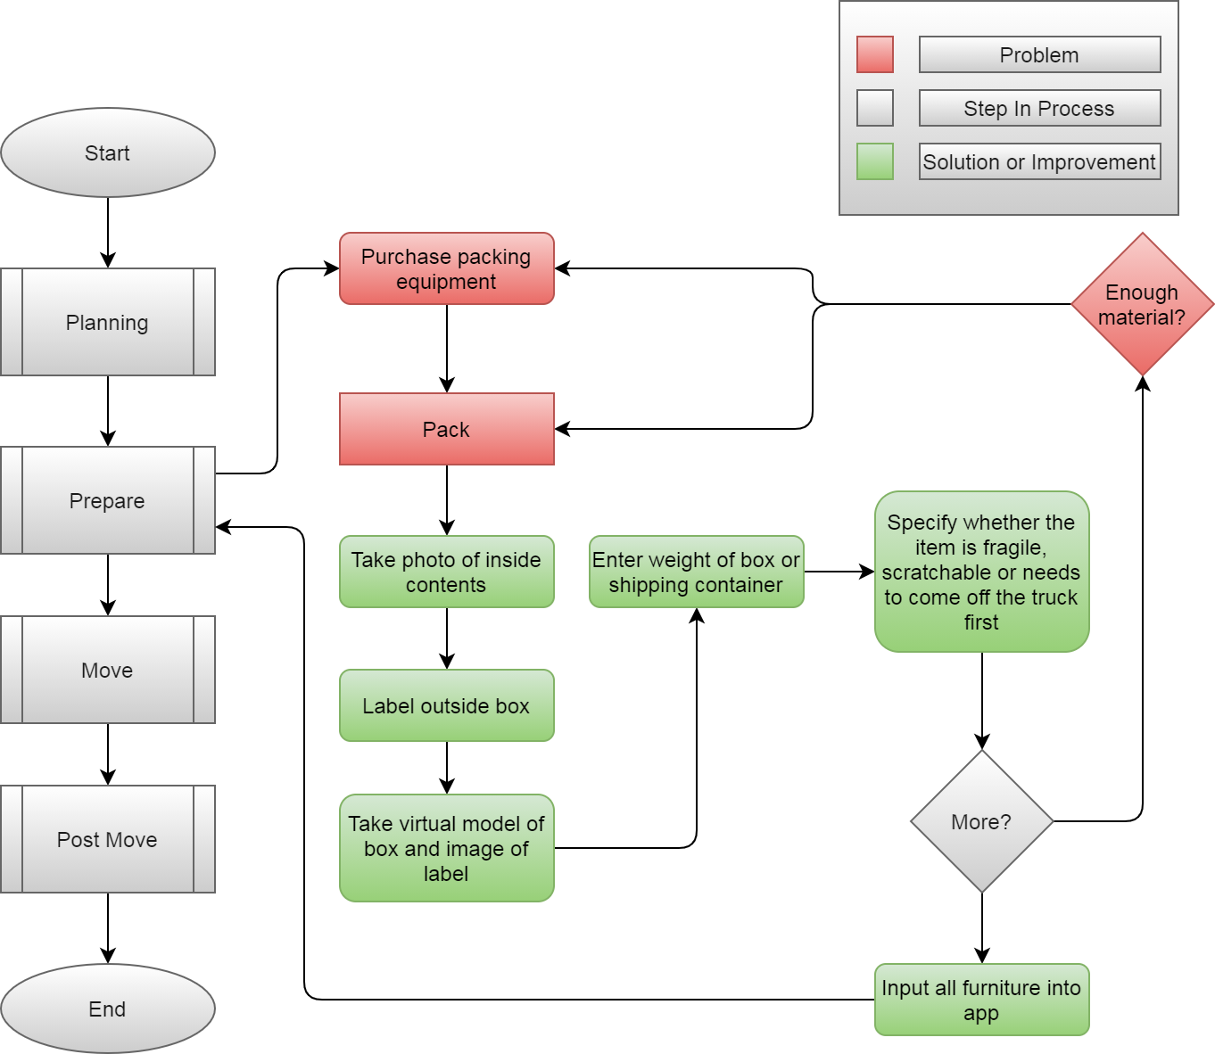

Slide 26
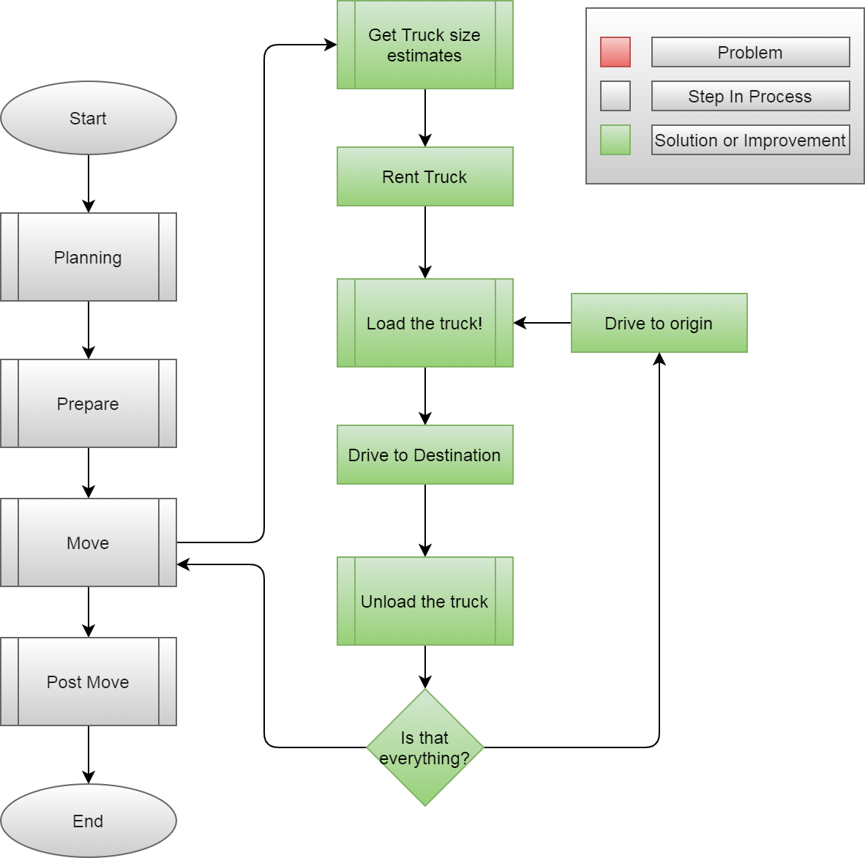

Slide 27
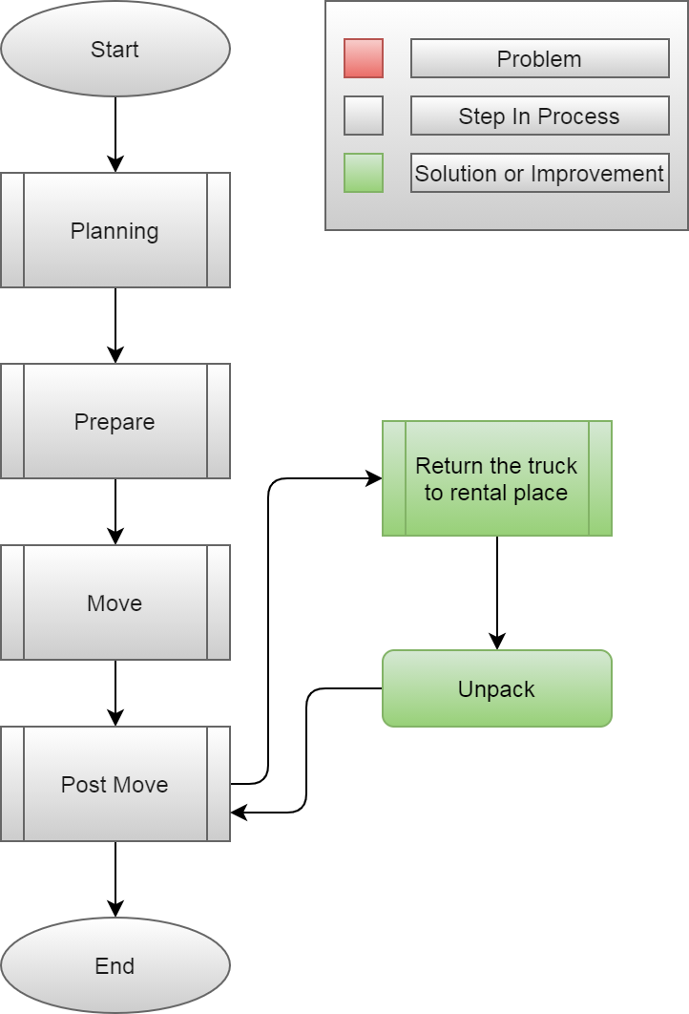

Slide 28
What are the major functional components?

Slide 29
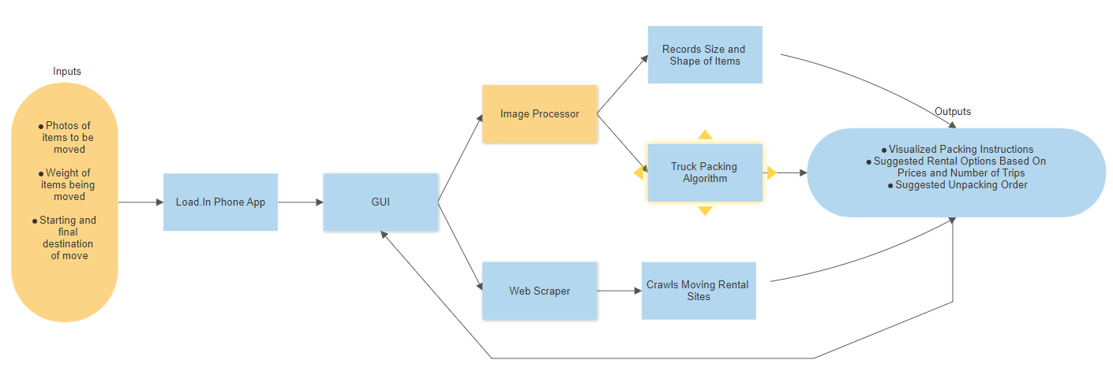

Slide 30
Feasibility Analysis

Slide 31
Per the rubric, add “Description of what proposed solution will do” here

Slide 32
Per the rubric, add “Description of what proposed solution will NOT do” here

Slide 33
Per the rubric, add “Market analysis & benefits to the customer base” here

Slide 34
Risks & Mitigation

Slide 35
Per the rubric, add “Customer Risks” here

Slide 36
Per the rubric, add “Technical Risks” here

Slide 37
What’s the competition like?

Slide 38
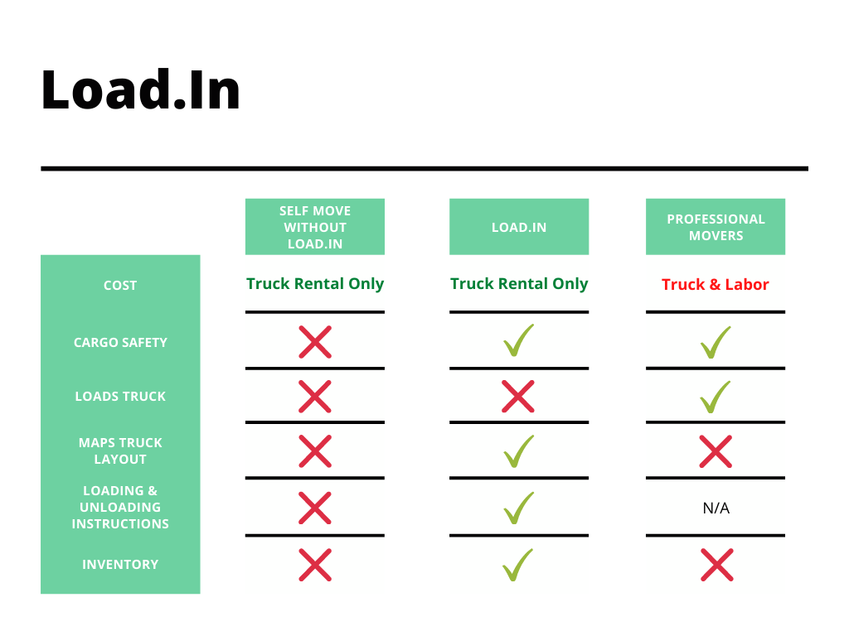

Slide 39
Notes:
End of presentation.

Slide 40
Sources:
The Top 5 Moving Mistakes Across America. (2019, August 13). Article. https://www.article.com/blog/top-5-moving-mistakes/
Economy Moving & Storage, LLC. (2015, January 4). How to properly pack and load a moving truck- Movers Cincinnati. YouTube. https://www.youtube.com/watch?v=rjmofUZOdwo&feature=youtu.be
CADCode Systems. (n.d.). Optimizing & Machining | CADCode Systems. CADCode.Com. Retrieved September 20, 2020, from https://www.cadcode.com/category/categories/optimizing-machining
Dube, E. (2020, September 20). OPTIMIZING THREE-DIMENSIONAL BIN PACKING THROUGH SIMULATION. Semantics Scholar. https://www.semanticscholar.org/paper/OPTIMIZING-THREE-DIMENSIONAL-BIN-PACKING-THROUGH-Dube/bb9986af2f26f7726fcef1bc684eac8239c9b853#references
Knoblauch, M. (2019, May 8). One in ten Americans would prefer a week in jail over moving. New York Post. https://nypost.com/2019/05/08/one-in-ten-americans-would-prefer-a-week-in-jail-over-moving/
The American Institute of Stress. (n.d.). The Holmes-Rahe Stress Inventory PDF. Retrieved September 20, 2020, from https://www.stress.org/wp-content/uploads/2019/04/stress-inventory-1.pdf
Wood, T. (2020, January 6). Moving Industry Statistics. MoveBuddha. https://www.movebuddha.com/blog/moving-industry-statistics/
Nat and Friends. (2017, April 18). Google Earth’s Incredible 3D Imagery, Explained. YouTube. https://www.youtube.com/watch?v=suo_aUTUpps&feature=youtu.be
Collins, T. (2018, April 20). A Look Into Photogrammetry and Video Games - Tiger Collins. Medium. https://medium.com/@homicidalnacho/a-look-into-photogrammetry-and-video-games-71d602f51c31

Slide 41
Glossary:
*All definitions are sourced from Wikipedia
Photogrammetry
Photogrammetry is the science and technology of obtaining reliable information about physical objects and the environment through the process of recording, measuring and interpreting photographic images and patterns of electromagnetic radiant imagery and other phenomena.
Algorithm
A finite sequence of well-defined, computer-implementable instructions, typically to solve a class of problems or to perform a computation.
Professional movers
Professionals who move all your belongings for you from one place to another.
Packing problems
Are a class of optimization problems in mathematics that involve attempting to pack objects together into containers. The goal is to either pack a single container as densely as possible or pack all objects using as few containers as possible.

